Slide 1












Un evento:
DECEMBER 4th, 2024
Seminario:
Con il Patrocinio di:
EVOLUZIONE DEL MERCATO DELLE FLOTTE
With the Patronage of:
Intervention by:
Ugo Papagni e Davide Bovio
Partner Platinum:
Partner:

Slide 2

Notes:
Google Capitalizzazione: $2,20 trilioni
Google ricerche mondiali al giorno: 8,5 miliardi
Amazon capitalizzazione: $2,17 trilioni
Amazon ordini mondiali al giorno: 22,5 milioni

Slide 3

Simple answers to increasing complexities
Notes:
Google Capitalizzazione: $2,20 trilioni
Google ricerche mondiali al giorno: 8,5 miliardi
Amazon capitalizzazione: $2,17 trilioni
Amazon ordini mondiali al giorno: 22,5 milioni

Slide 4
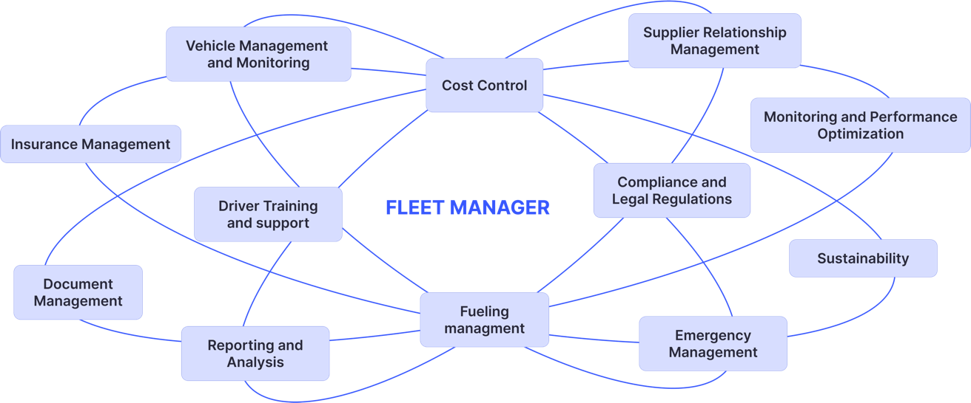
The daily challenges of Fleet Managers

Slide 5

Your opinion
Multiple interactions with service providers
Emerging challenges with greatest impact on corporate fleet management
Multiple internal organizational interactions
Cost containment while maintaining the same level of service
Environmental sustainability
Complexity of the regulatory framework
Notes:
Abbiamo chiesto ai vostri colleghi Fleet manager quali tra queste sfide possano avere un impatto molto alto sulla gestione delle loro flotte aziendali. Il risultato che abbia o ottenuto è che…

Slide 6
Your opinion
Ways of addressing increasing complexity of corporate fleet management
Training programs
Implementation of digital tools
Staff increase
Outsourcing and collaboration
with external experts
Notes:
Abbiamo chiesto ai vostri colleghi Fleet manager quali tra queste sfide possano avere un impatto molto alto sulla gestione delle loro flotte aziendali. Il risultato che abbia o ottenuto è che…

Slide 7
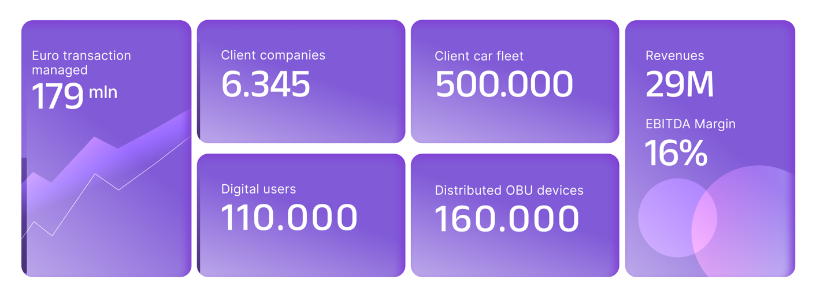
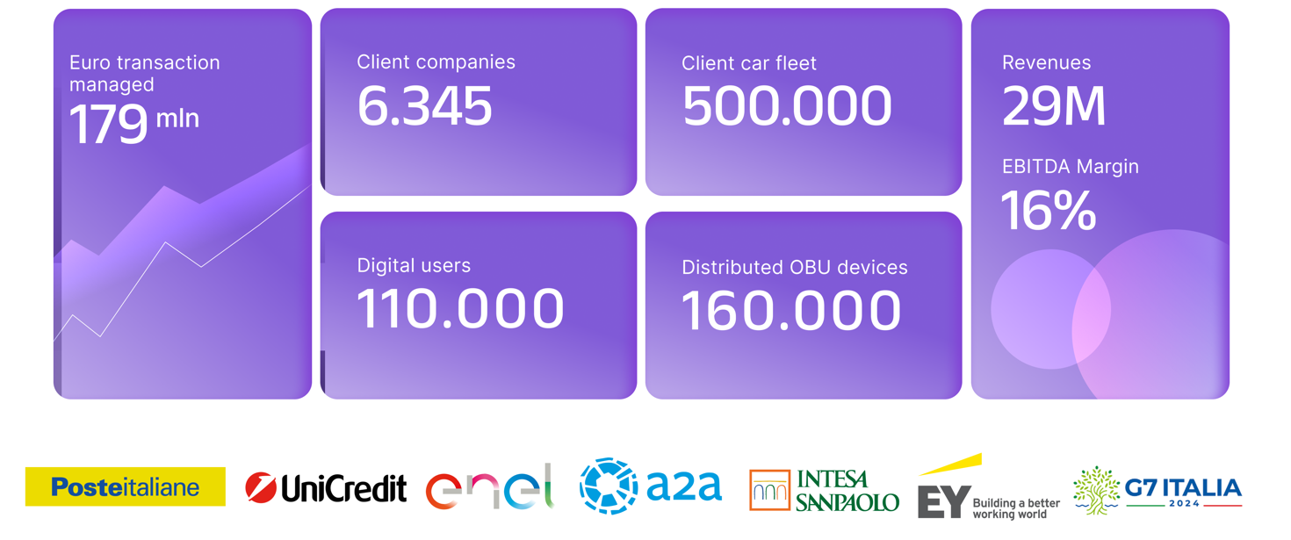

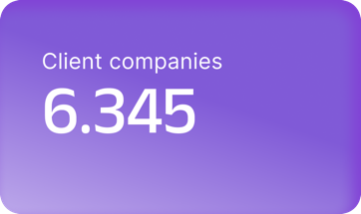
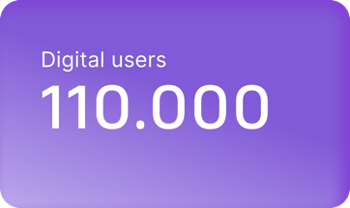
Bloomfleet

Slide 8
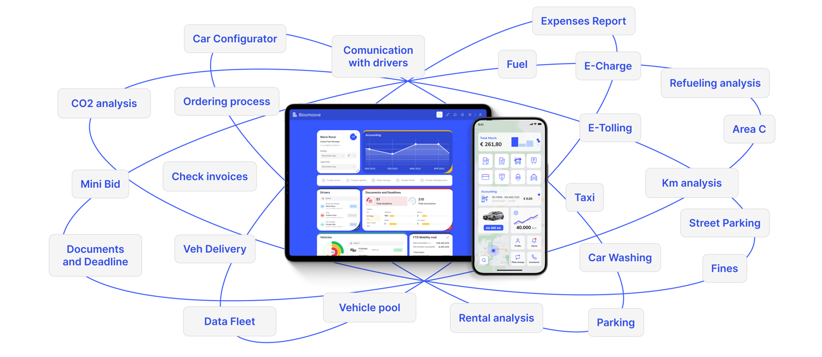
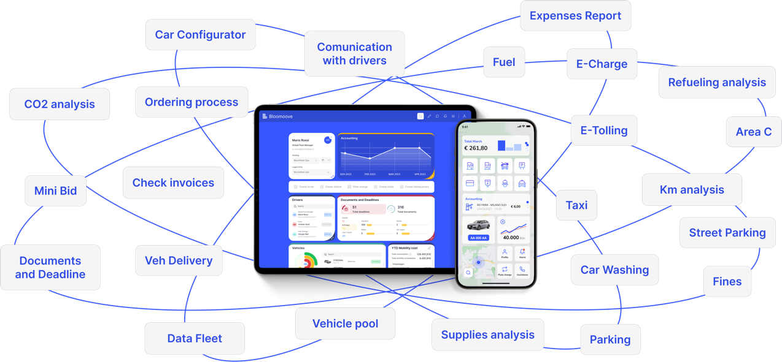
Bloomoove ecosystem

Slide 9

Shell Fleet Solutions
A business that Shell invented to serve business Mobility Customers
#1
Network
∼ 8,5 Million
Active Shell Cards
Shell Card is widely accepted worldwide
∼ 220 Million
Transactions per year – 99,99% uptime
Business Mobility of goods
Long haul, multimodal, last mile delivery,
Diesel, LNG, H2, advanced controls, road services and maintenance
Business Mobility of people
Fleet management, e-mobility & CO₂ compensation, Telematics
Largest payment platform
In business mobility – 99,99% payments authorized in 1,5s
9

Slide 10






Shell Fleet Solutions
API
Fleet Management
ITALY
SHELL CARD
∼ 5.000.
Accessible service stations
54.500+
Charging Points
Fuel card for traditional fuelings and electric charges
Carbon
Compensation
EUROPE
30.000
Accessible service stations
750.000+
Charging Points
10

Slide 11
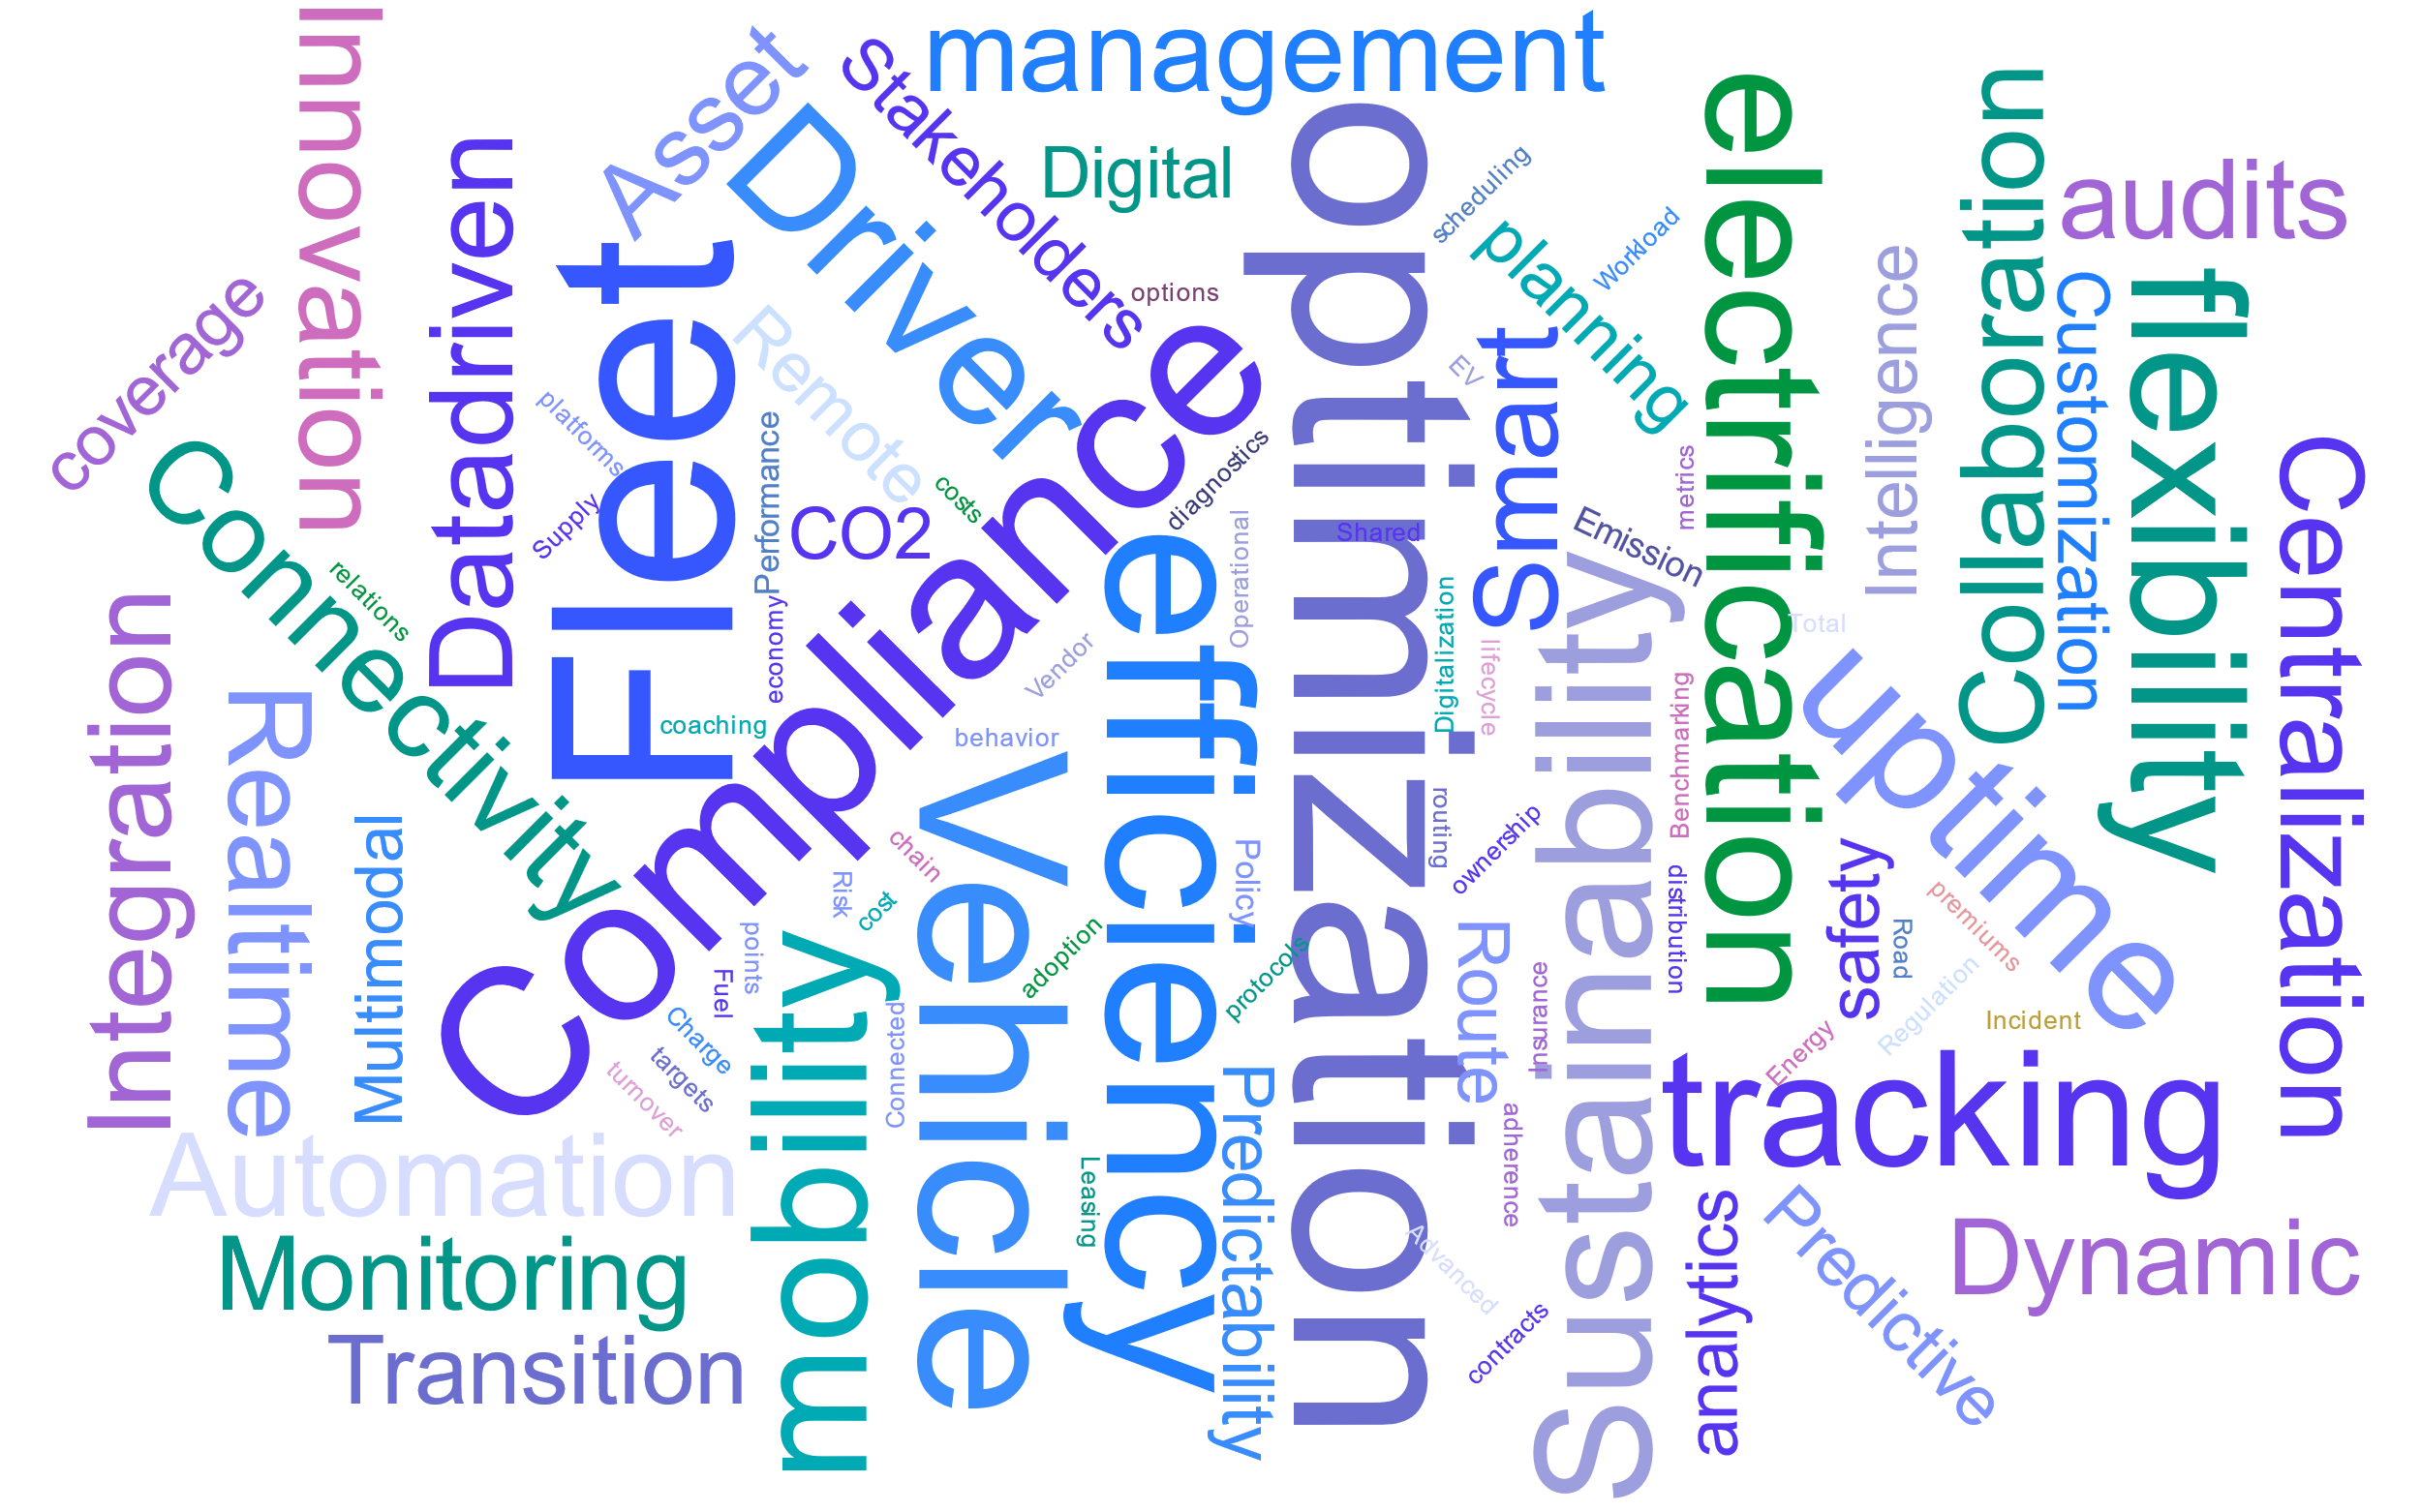


The ecosystem response to emerging needs

Slide 12

Thank you for your attention

